Slide 1
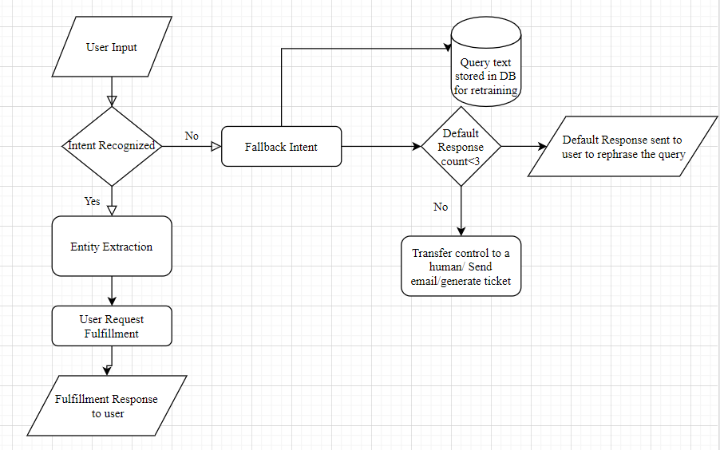
Sample Conversation flow
User enters a query.
If intent is not recognized, fall back intent is triggered, default response sent at most 3 times, after that manual intervention if required.
Store the failure scenario in the DB for retraining of the bot.
If intent is recognized, try to extract any entity if possible.
Try to fulfill the user request based on intent and entity extracted.
Send the response after fulfillment.

Slide 2
Answers
What kind of algorithm you will use?
Naïve Bayes
RNN LSTM
How does the bot understand what the customer is saying?
The bot will be trained with the sample user utterances for individual intents.
This will require a lot of labelled data to train our model with
What if you encounter with a new question that bot didn’t see while training?
For that a default response will be sent till a specified number of times. After that manual intervention might be required.
How does the bot continue to learn once it’s live? Or how can I make sure that my bot won’t turn crazy and start speaking nonsense?
We’ll log all those utterances for which our bot was not able to recognize an intent. Then that data will be labelled with the correct intent and then again will be used for retraining the model.
How would you optimize when thousands of users will be interacting with the bot?
Some of the ways will be:
Use LB to redirect requests
Use Dockers and Kubernetes to scale up the application as per need.
Note: There are a lot of chatbot building platforms which are present which actually reduce our overhead to do all the data labelling and model training. We can also think to use them, For example RASA.

